Slide 1


Graphics and Computational Programming
Maria Tozo

Slide 2
Project Information
For that for this project I decided To do a Parallel Ray Tracer. The end result was a parallel ray tracer that is able to render spheres with multiple lights and different materials that interact with the scene to produce shadows and reelections.
Through this Presentation I will go over and Discuses my research into ray tracing and parallel programing and how I used said research in Designing and implementing the project.

Slide 3


Theory

Slide 4

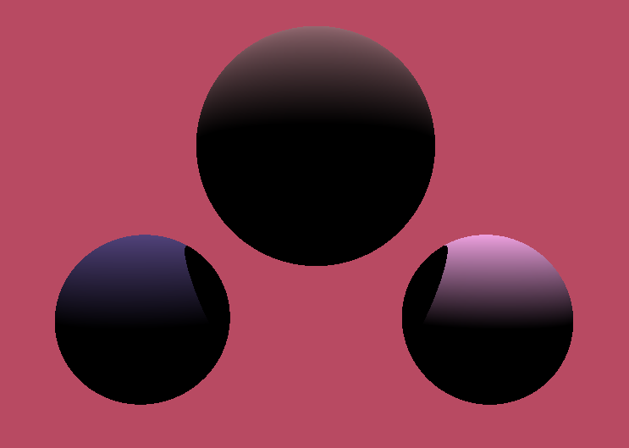
Ray Tracing - History
Ray Tracing is the process of rendering a 3D images on a 2D display by tracing a path of light through pixels on an image plane. Though ray tracing is capable of producing a much higher degree of realism over other rendering methods, it comes a much greater computational cost. This cost was fine for producing images in TV and film had been much to high for games to implement into real-time. But with technological advances, like the Nvidia GeForce RTX 2080, it is slowly becoming possible for real-time.

Slide 5
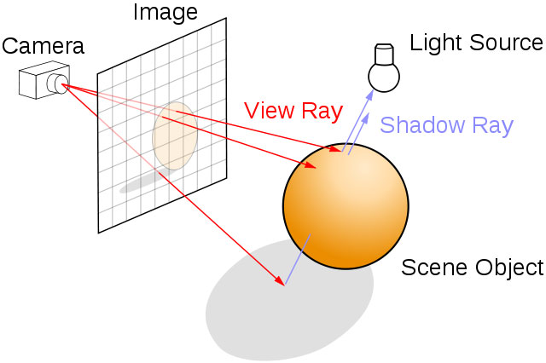
Ray Tracing - Camera
This Photo by Unknown Author is licensed under CC BY-SA

